Slide 1
Movie Trailer Presentation.
Hopeful love
Elisha Shauna ABBIE

Slide 2
INITIAL IDEA
Initial idea
Lesbian rom-com.
  College students
  Date
  1 of a couple is leaving via train
  Lesbian couple in date in park
  Dubbed narration
  Initial Poem voice over
Summary
Shots of a lesbian couple walking through the park, with implications of them being on a date, and them spending time together at home. Really cinematic shots experimenting with different types of framing. A poem voice over from the point of view of one of the girls which tells their story and the state of their relationship.
Notes:
Initial Idea

Slide 3
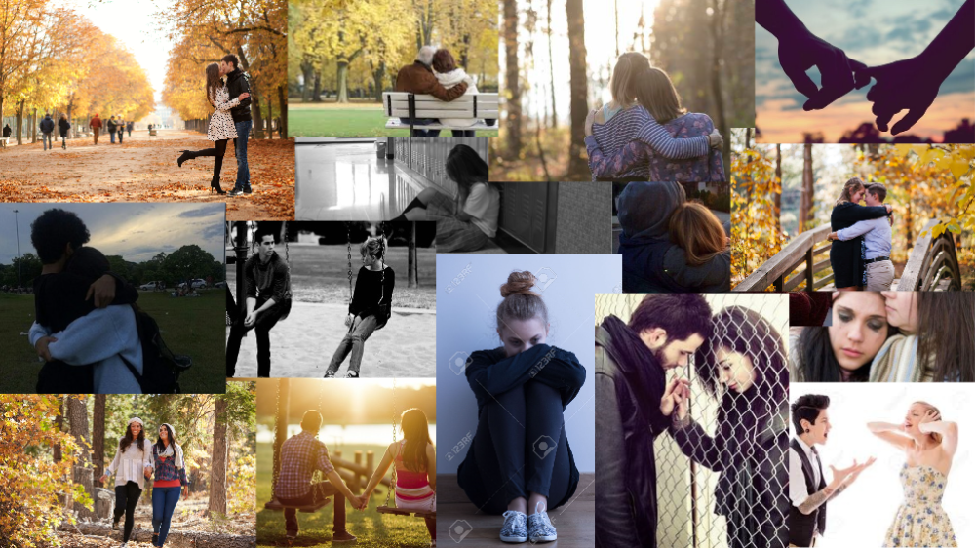
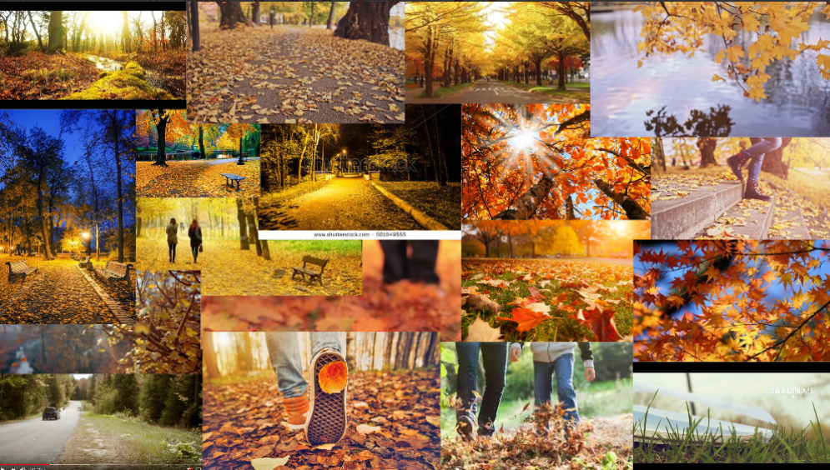
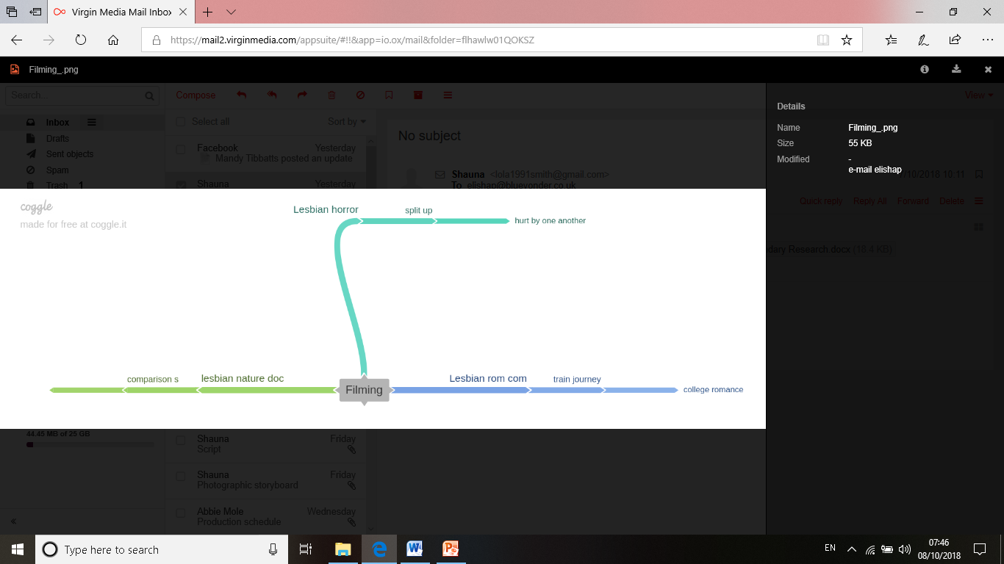
MOOD BOARD & MIND MAP
Notes:
Mind Map & Mood Board.

Slide 4
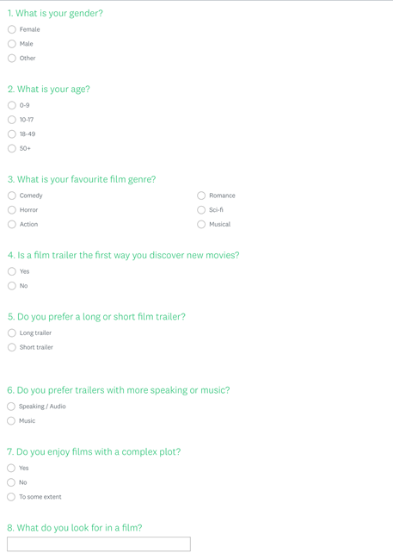
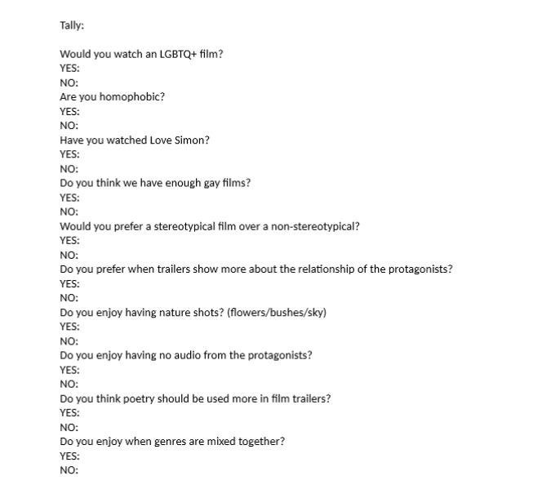
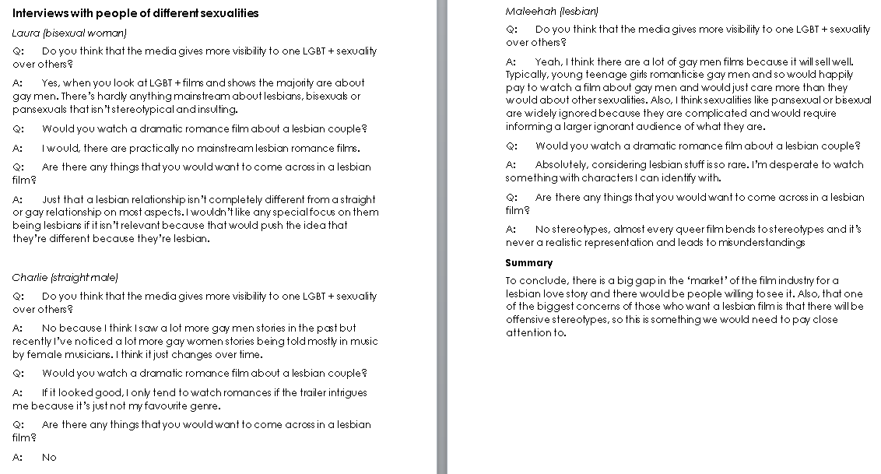
PRIMARY RESEARCH
Primary Research
Tally
Shauna
Primary Research
Interviews
Abbie
Primary Research
Survey
Elisha
Notes:
Primary Research

Slide 5
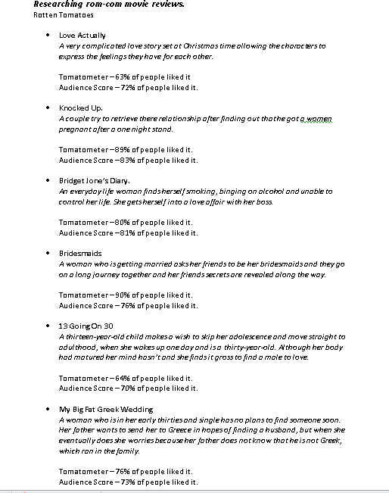
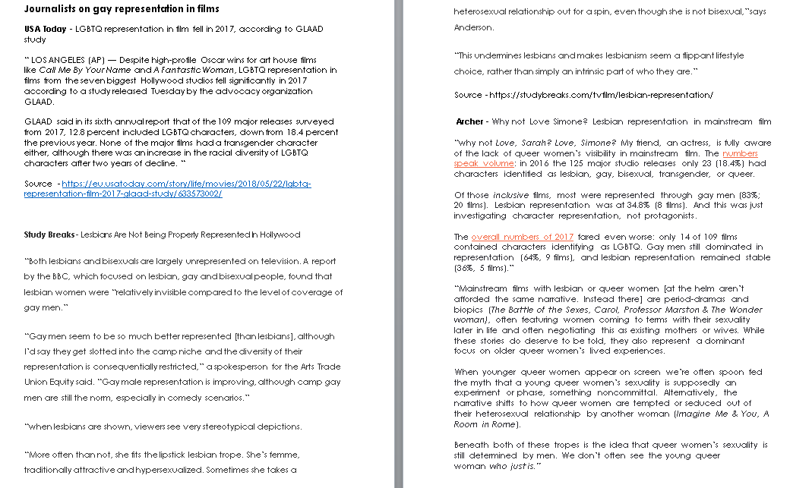
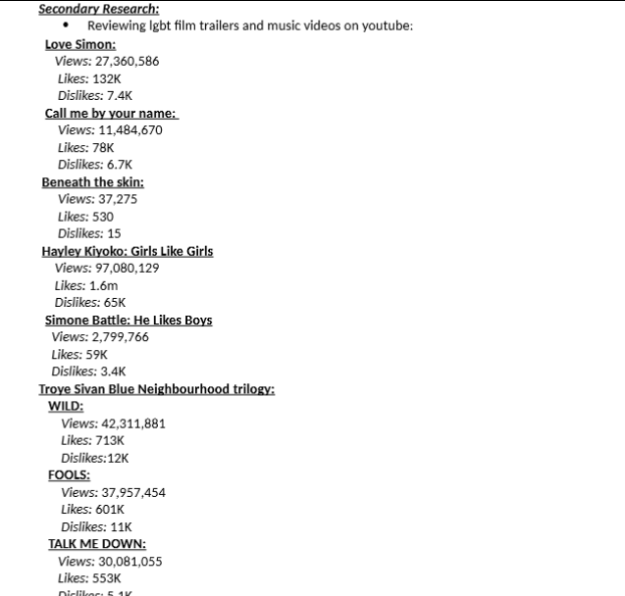
SECONDARY RESEARCH
Secondary Research
Articles
Abbie
Secondary Research
Rotten Tomatoes Reviews
Elisha
Secondary Research
YouTube Reviews
Shauna
Notes:
Secondary Research

Slide 6
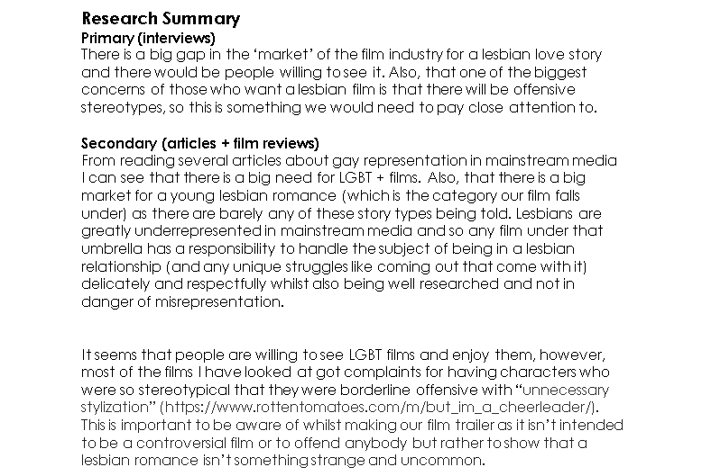
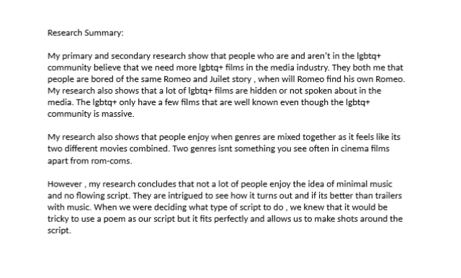
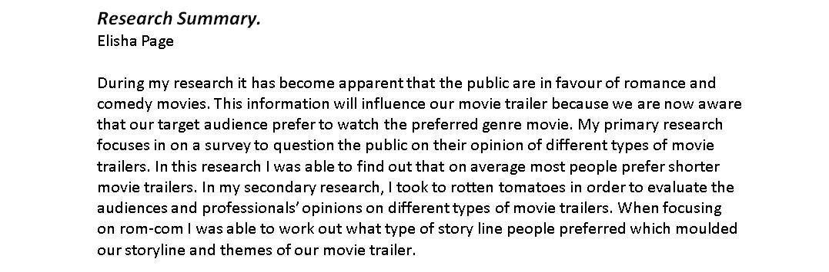
RESEARCH SUMMARY
Research Summary
Shauna
Research Summary
Abbie
Research Summary
Elisha
Notes:
Research Summary

Slide 7
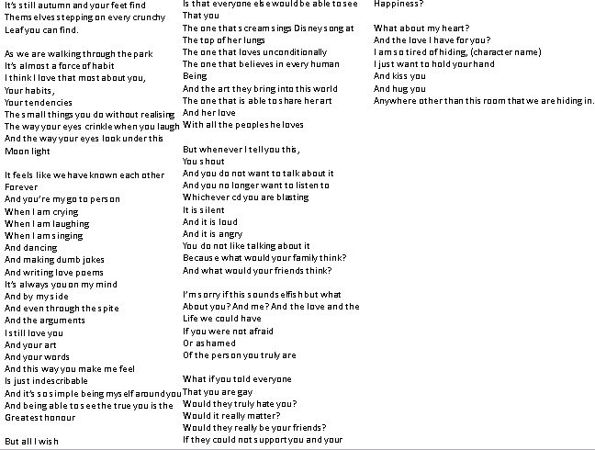
SCRIPT
A piano instrumental (If I Could Fly) will play in the background of the narration to add more of an emotional effect and will also help the whole trailer flow.
Notes:
Script

Slide 8
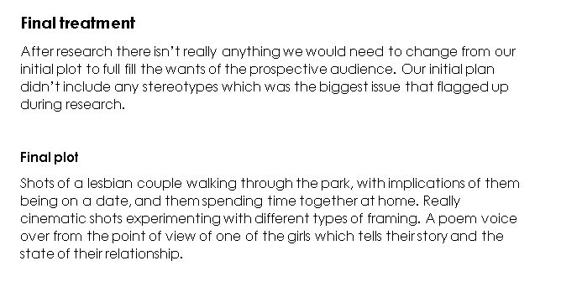
FINAL TREATMENT
Notes:
Final Treatment

Slide 9
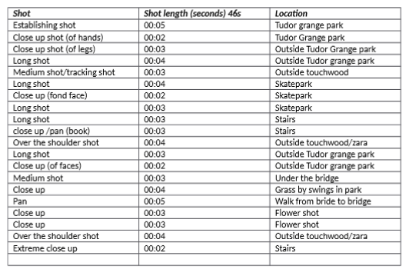
SHOT LIST
Notes:
Shot List

Slide 10
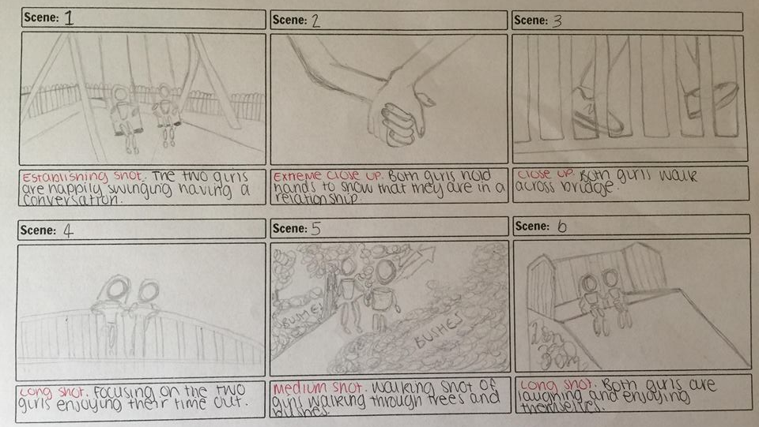
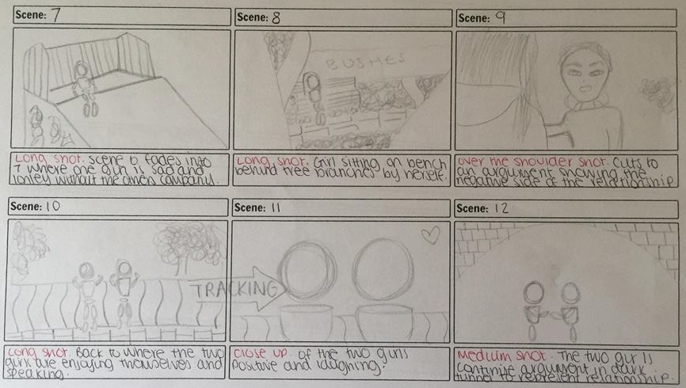
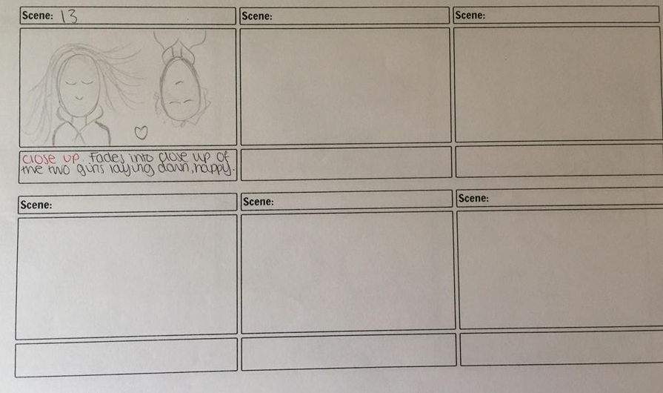
STORYBOARD
Notes:
Storyboard

Slide 11
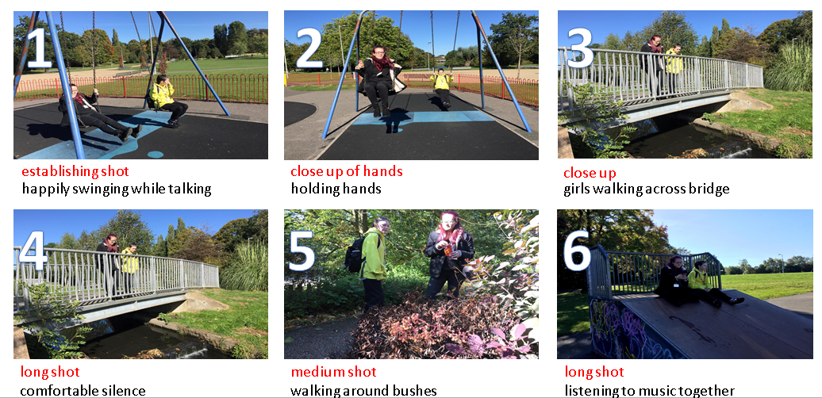
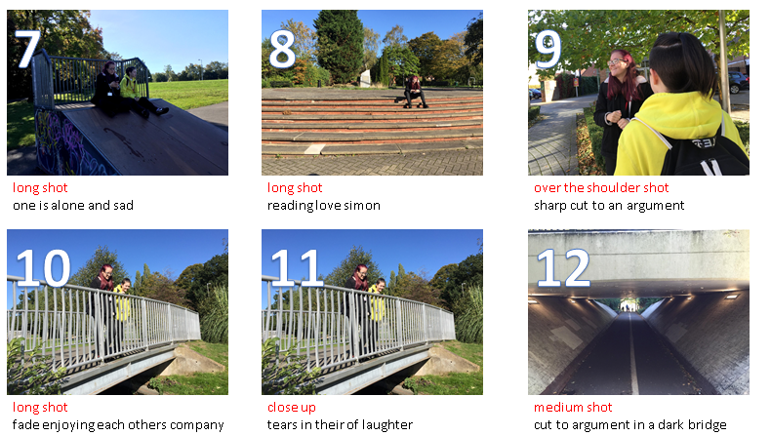
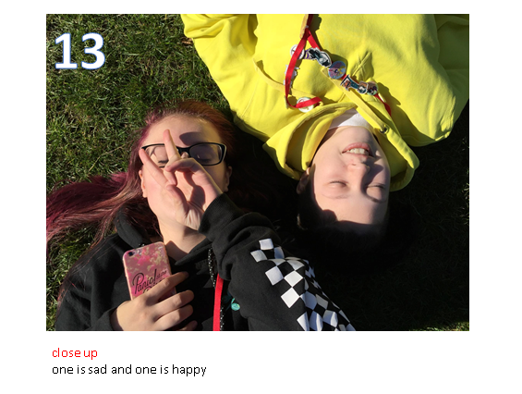
PHOTOGRAPHIC STORYBOARD
We have chosen to stick to the handheld filming option because if the camera is rocky it will reflect the narrative of the rocky relationship.
Notes:
Photographic Storyboard

Slide 12
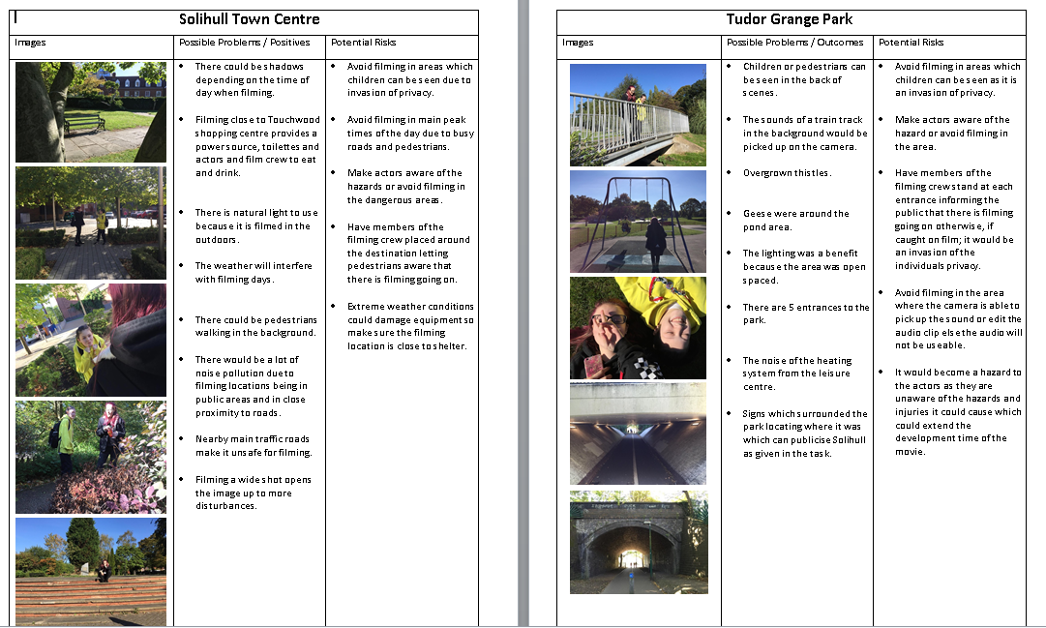
LOCATION RECCE
We will use natural daylight to reflect their positive relationship.
The use of dull daylight will reflect their negative relationship.
Notes:
Location Recces

Slide 13
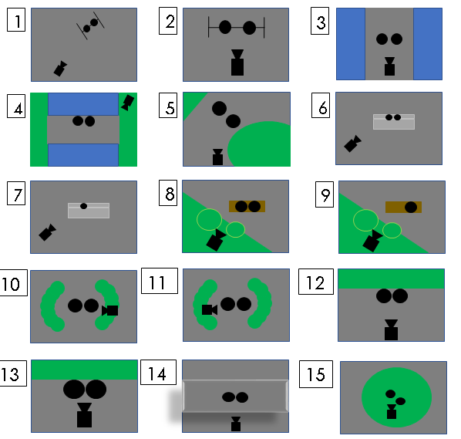
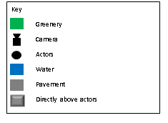
FLOOR PLAN
Notes:
Floor Plan

Slide 14
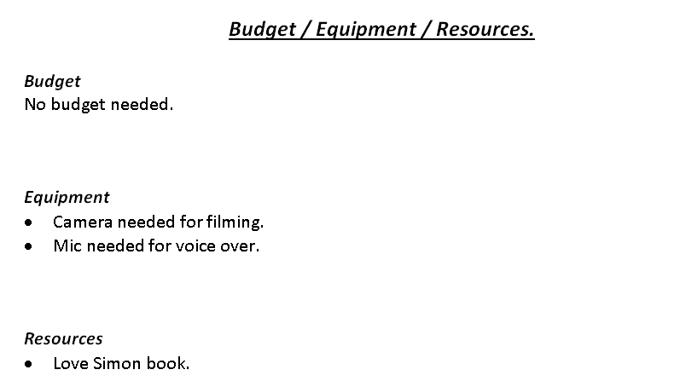
BUDGET / EQUIPMENT / RESOURCES
Notes:
Budget / Equipment / Resources

Slide 15
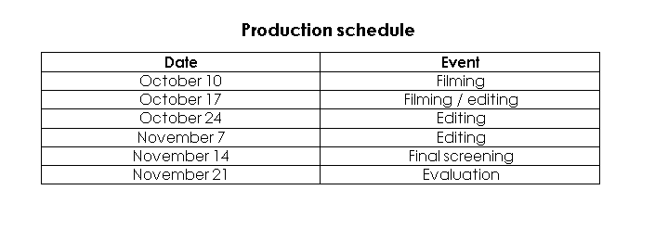
PRODUCTION SCHEDULE
Notes:
Production Schedule

Slide 16
Thank you for listening.
Are there any questions?

